Slide 1

職場故事
Notes:
https://pixabay.com/videos/discussion-desk-people-office-team-8252/

Slide 2
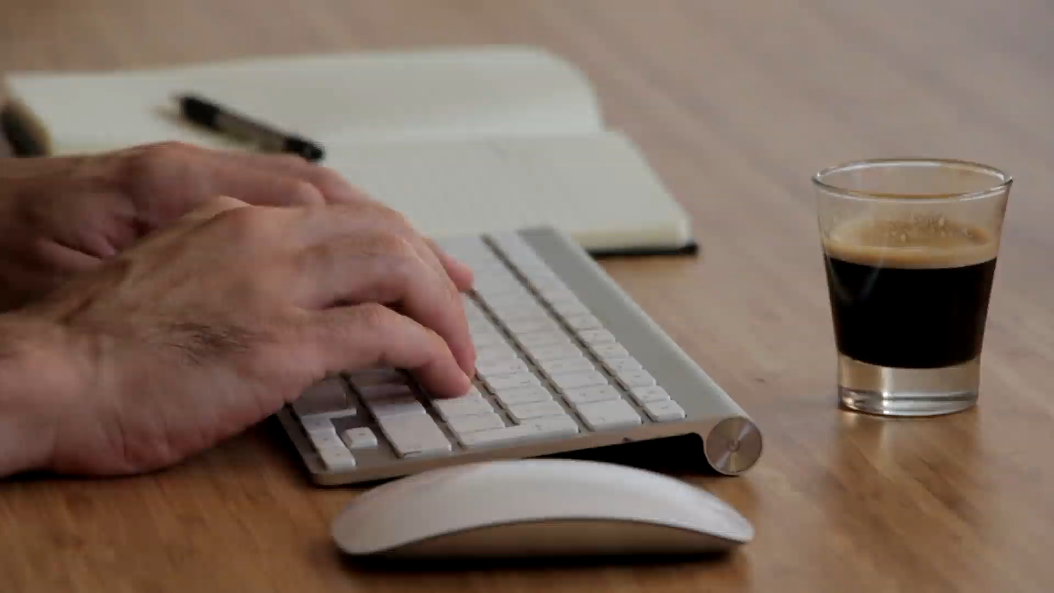
1. 目標
Notes:
https://pixabay.com/videos/keyboard-hands-writing-computer-1046/

Slide 3

2. 阻礙
Notes:
https://pixabay.com/videos/macro-clock-glitter-mechanism-time-34855/

Slide 4
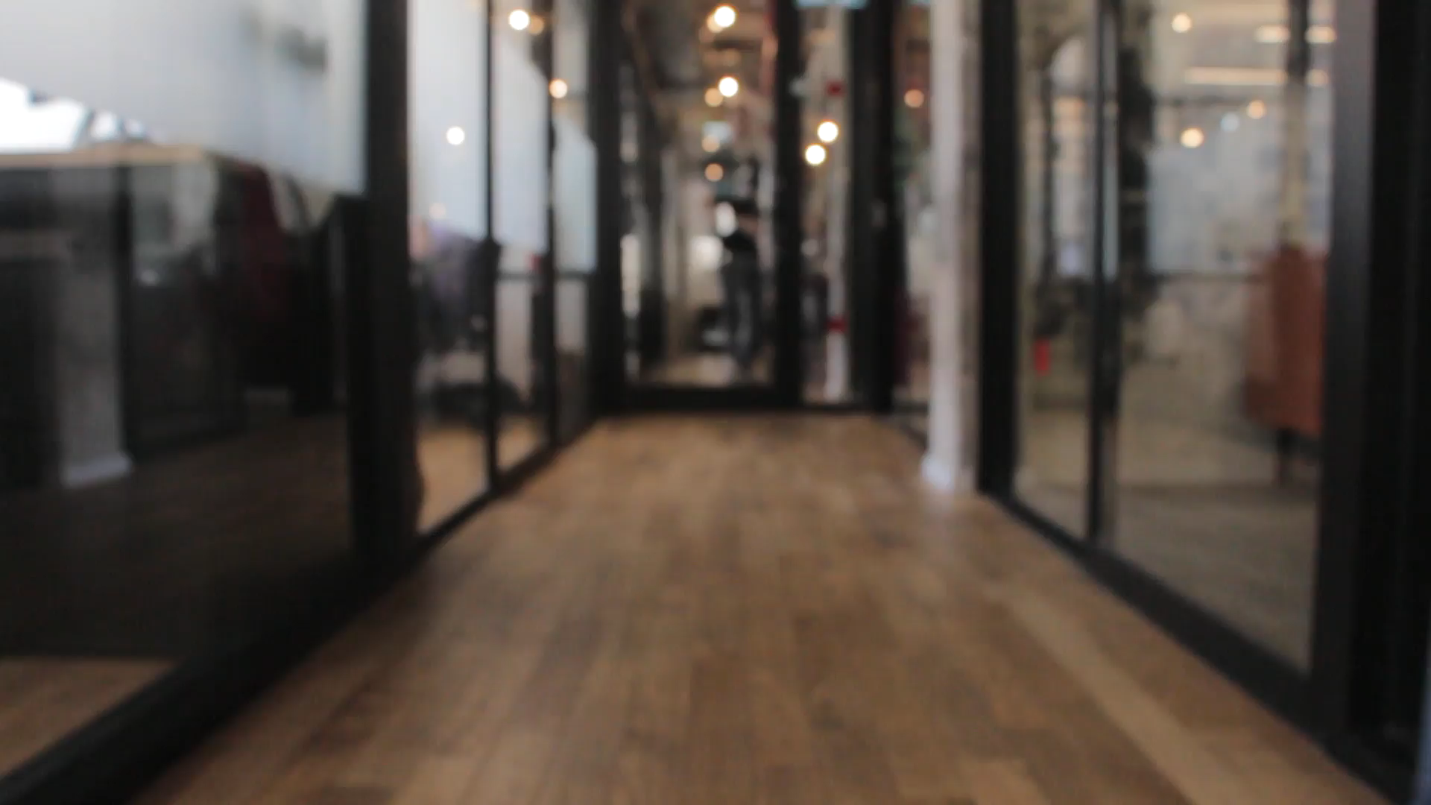
3.努力
Notes:
https://pixabay.com/videos/busy-office-people-indoors-4723/

Slide 5

4.結果
Notes:
https://pixabay.com/videos/counseling-therapy-mental-health-147244/

Slide 6

5.意外
Notes:
https://pixabay.com/videos/boss-employee-talking-angry-202135/

Slide 7
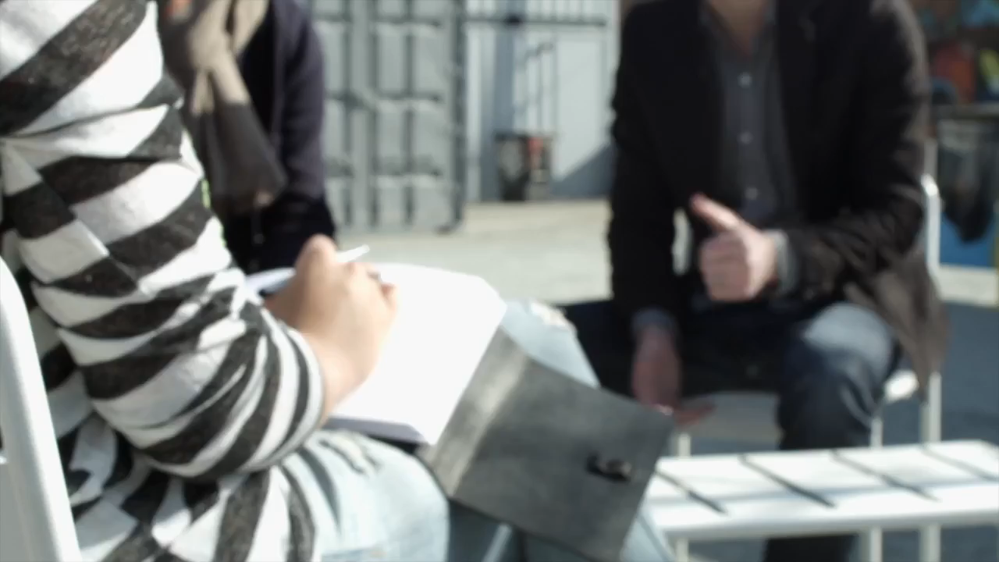
6.轉彎
Notes:
https://pixabay.com/videos/talk-discussion-meeting-team-group-1112/

Slide 8

7.結局
Notes:
https://pixabay.com/videos/contract-agreement-firm-business-198890/

Slide 9
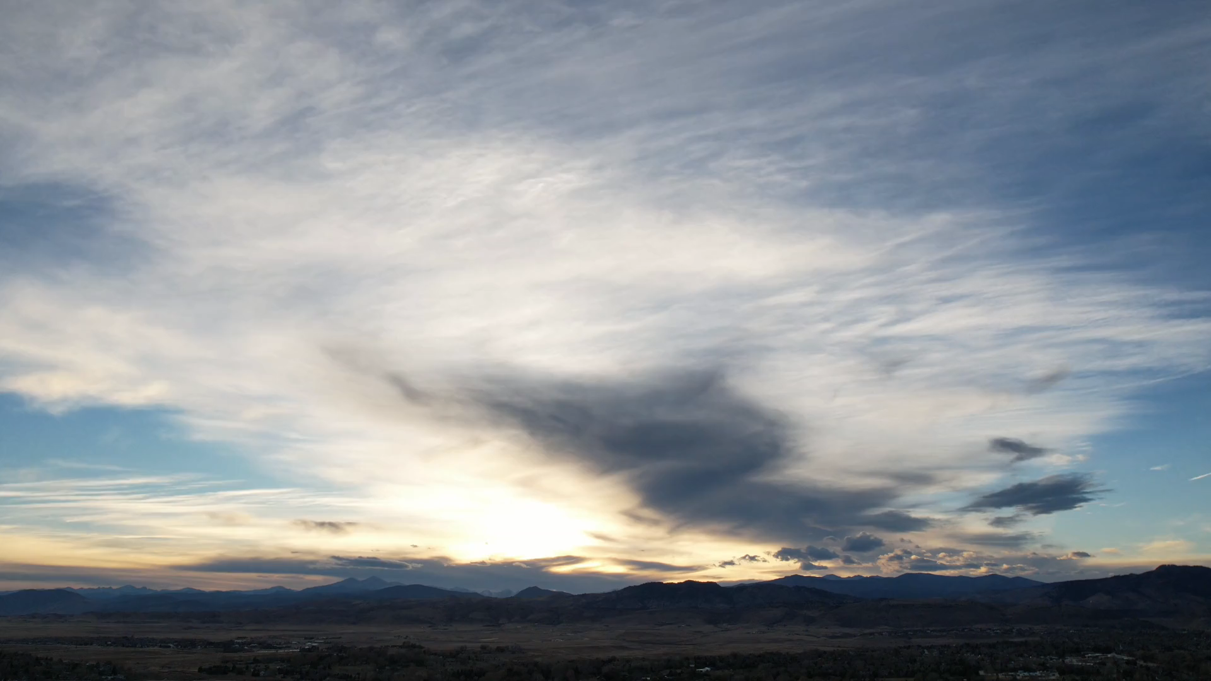
謝謝
Notes:
https://pixabay.com/videos/atmospheric-sky-clouds-cloudscape-190332/

